Slide 1
Document viewing for policies

Slide 2
summary
Document Viewing Release 1:
Users will be able to view documents for issued policies on the Policy Details page.
Documents available for viewing include FloodPro (older) documents and new policy documents uploaded on Trident
Users will be able to download documents for viewing.
User Journey:
Search for the policy that you want to view documents for.
On the policy details page, click on the “documents” tab on the policy details page.
User focus is on document viewing, with newest documents listed first.
User can change the sort to oldest first, or can change sort alphabetically by document type.
The user selects the document that they want to view by clicking the “download” icon for the document.
To go back to the policy detail page, click the “summary” tab

Slide 3
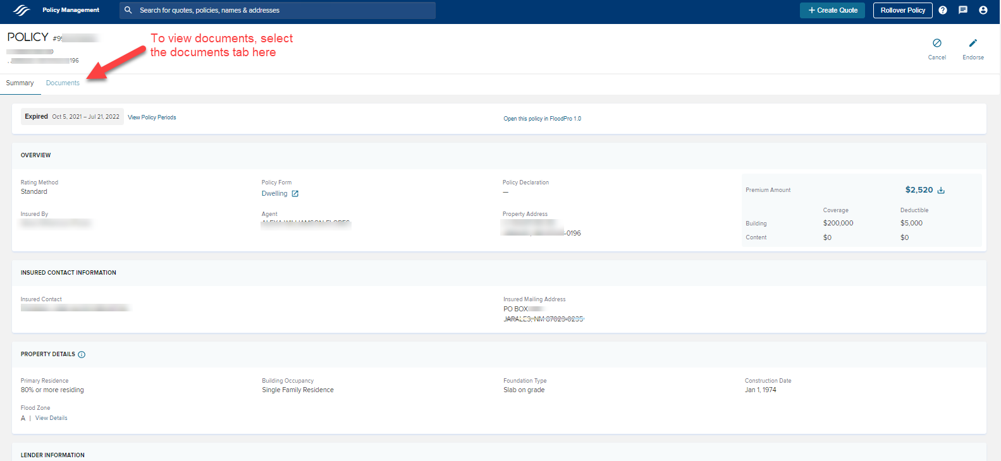
Documents tab

Slide 4
About document viewing
Documents are displayed as newest first. Click “Received Date” to change the filter to Oldest First.
If you want to change the sort by Document Name, Click the “Document Name” header.
To view a document, click the “download” icon for the document that you want to view.
To go back to the policy details page, click the “summary” tab.
Use the scroll bar to view more documents on the page.
Use the next page arrow to navigate to the next page of documents.

Slide 5
What’s in & what’s out
Item | What is included in Day 1 functionality | What’s not included
Policy Declaration Pages, Renewal Notices (Bills), Expiration Notices, Non-Renewal Notice | Any Declaration Page, Renewal Bill, Expiration Notice, and Non-Renewal Notice that has been printed will be visible in the document center. | A document not previously not generated will not be available
View application documents submitted on Trident for Issued Policies | Any document uploaded on the policy builder page is included on the Policy Details document viewing page. | Primary Residence electronic signature documents and on-site attestations
Underwriting documents submitted in FloodPro or Nautilus | Any document that is indexed to the policy number will be visible in the document center. | Documents indexed to only the quote number (and not the quote + policy number) will not be visible in the policy’s document center.
CSR letters (Underwriting Letters) | Any underwriting letters associated with the policy number will be visible in the document center. | Underwriting tasks created on Trident are not CSR letters; the task info is not part of the document center.
Flood Zone Determination Information | Legacy (FloodPro) Flood zone determinations and zone recertifications that are part of the nautilus file are included in the document center. Flood zone override verification documents provided in Trident are included. | Flood Zone determinations that are systematically run in Trident are not included.
New Business Applications | Legacy (FloodPro) New Business Applications that are part of the nautilus file are included in the document center | Trident new business applications for new policies created in Trident are not included. Trident does not image the new business application.
Endorsement Applications | Legacy (FloodPro) Endorsement Applications for endorsements that were created and submitted via FloodPro are included | Trident endorsement applications for any endorsement created and submitted in Trident are not included. Trident does not image the endorsement application.
Renewal Billing Changes / Endorsements (Renewal Builder Changes) | Legacy (FloodPro) Renewal Endorsement Applications for Renewals that were created and submitted via FloodPro are included.Legacy (FloodPro) Revised Renewal Billing Notices generated from the renewal endorsement application are included. | Renewal billing changes made in the Trident Renewal Builder page are not included; as Trident does not image a renewal application. Revised Renewal Notices for Trident renewals do not create revised renewal notices. Therefore, these will not be included until the trident defect is resolved.

Slide 6
The documents tab shows all documents, with newest shown first

Slide 7
A Documents tab is now available on the policy detail page

