Slide 1
File a Claim
September 2022

Slide 2
1. Search for the policy that has had the loss.

Slide 3
2. Select the policy from search results.

Slide 4
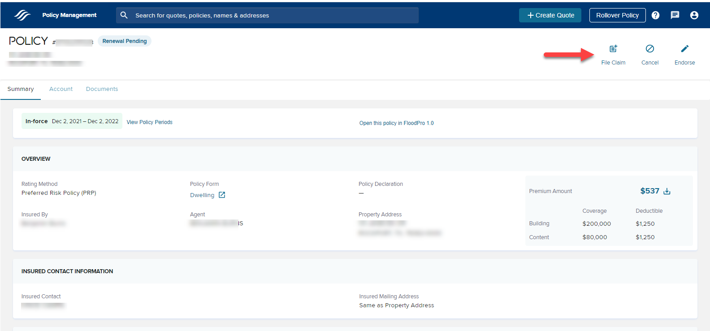
3. User lands on the Policy Summary Page. Click the “File Claim” button.

Slide 5
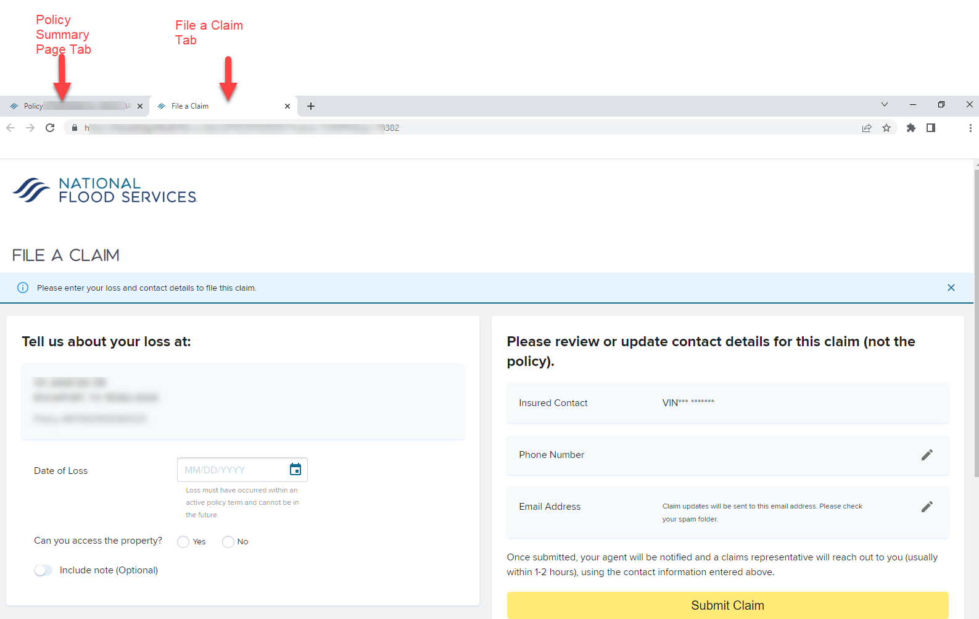
4. The First Notice of Loss page opens in New Tab. User focus is on “File a Claim”

Slide 6
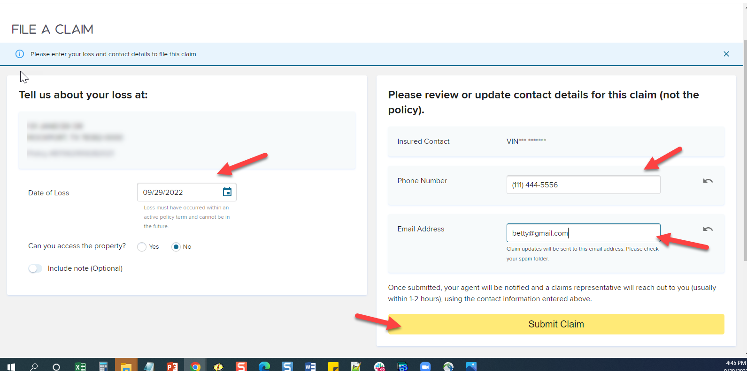
5. Fill in the form and click “Submit Claim”

Slide 7
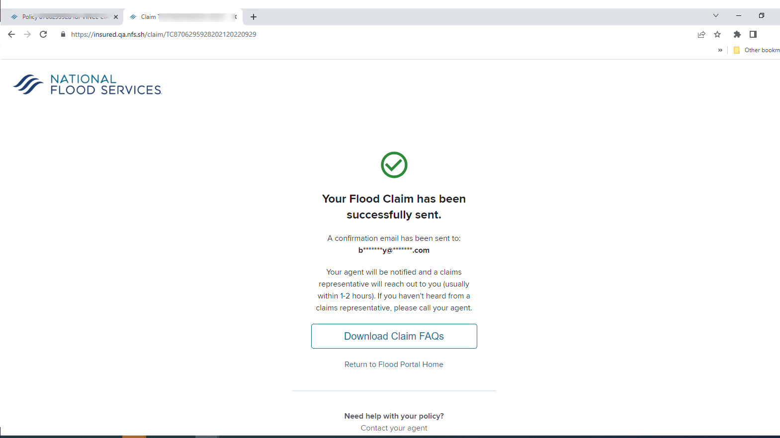
6. Success Message is Displayed. Email is sent to the insured email address provided on the “file a claim” page. The insured receives an email with claim information.

Slide 8
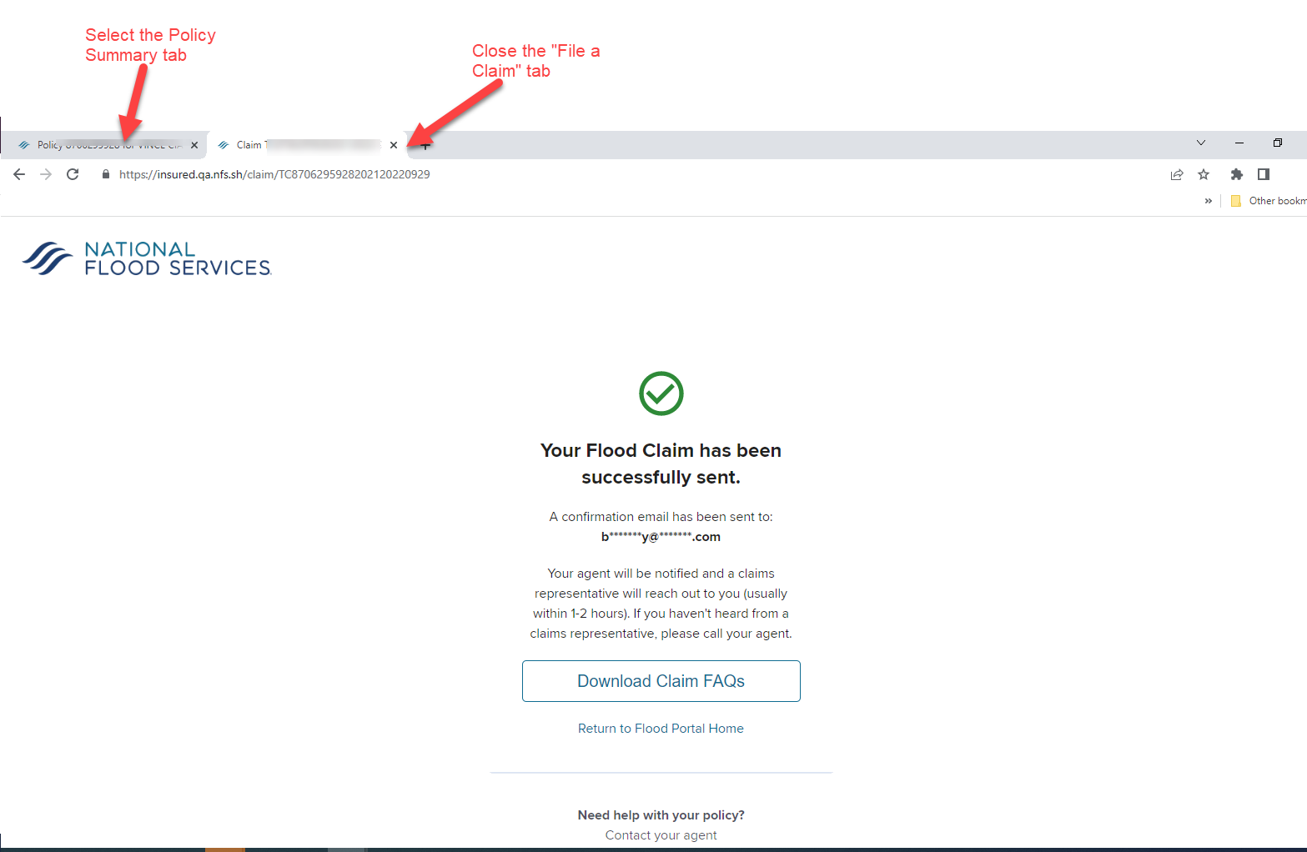
7. To go back to the policy, close the tab for “file a claim” or just select the “policy summary” tab.

Slide 9
8. Insured email with claim info.

